Slide 1
COLLEGE OF THE ENVIRONMENT
Office of Academic Affairs, Office of the Dean
Thank you for joining us! Our orientation program will begin shortly

Slide 2
WELCOME! College of the Environment
New Graduate Student Orientation
Friday, September 22, 2023
Notes:
Welcome to the College of the Environment! We are happy that you are with us. This is our annual new Graduate Student Orientation, and we are looking forward to showcasing some of the things that we, in the College and the University of Washington community, do in service of our graduate students. This is a favorite event of the year, where we get to welcome you to UW and the College.

Slide 3
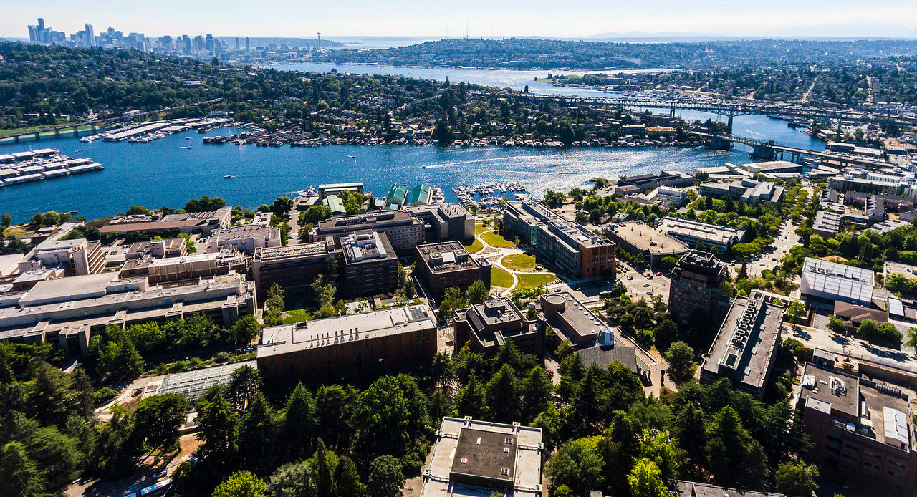
HONORING PLACE
The University of Washington acknowledges the Coast Salish peoples of this land, the land which touches the shared waters of all tribes and bands within the Suquamish, Tulalip and Muckleshoot nations.
Notes:
Before we begin, the University of Washington acknowledges the Coast Salish peoples of this land, the land which touches the shared waters of all tribes and bands within the Suquamish, Tulalip and Muckleshoot nations.

Slide 4
College of the Environment Dean's Welcome
Julia Parrish
Associate Dean, Academic Affairs
Notes:
Some of the resources and means of connections can also be found at the Graduate School. Let me welcome Jaye Sablan from Core Programs in the Graduate School..
Thank you, Jaye for joining us!

Slide 5
COLLEGE OF THE ENVIRONMENT
Atmospheric Science (MS, PhD)
Earth and Space Science (MS, PhD)
Oceanography (MS, PhD)
Quantitative Ecology and Resource Management (MS, PhD)
School of Aquatic and Fishery Sciences (MS, PhD)
School of Environmental and Forest Sciences (MS, MFR, PhD)
School of Marine and Environmental Affairs (MMA)
Notes:
We’re considered a small College, but we have a HUGE reach and a tremendous impact
We have 17 exciting research and outreach centers and
70 labs, research groups and cooperative programs that create a tremendous impact on our local, regional, state, national and global communities!

Slide 6
COLLEGE OF THE ENVIRONMENT
Inter/Transdisciplinary Programs
Astrobiology (PhD)
Concurrent Degrees
JSIS
Evans School
AIS

Slide 7
CERTIFICATE PROGRAMS & OPTIONS
Climate Science
Astrobiology
Data Science (available in ATMOS, OCEAN, SAFS)
Notes:
As you begin your studies and research here, please know that there are certificate programs available to you that may be of interest. Be sure to check out our Climate Science and Astrobiology programs. For these of you in the Atmosphere Sciences department and School of Oceanography, we have a Data Science certificate program option available to you.

Slide 8
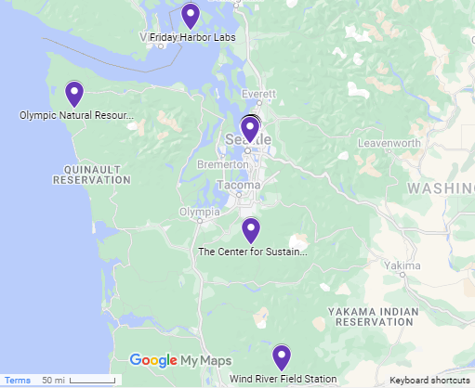
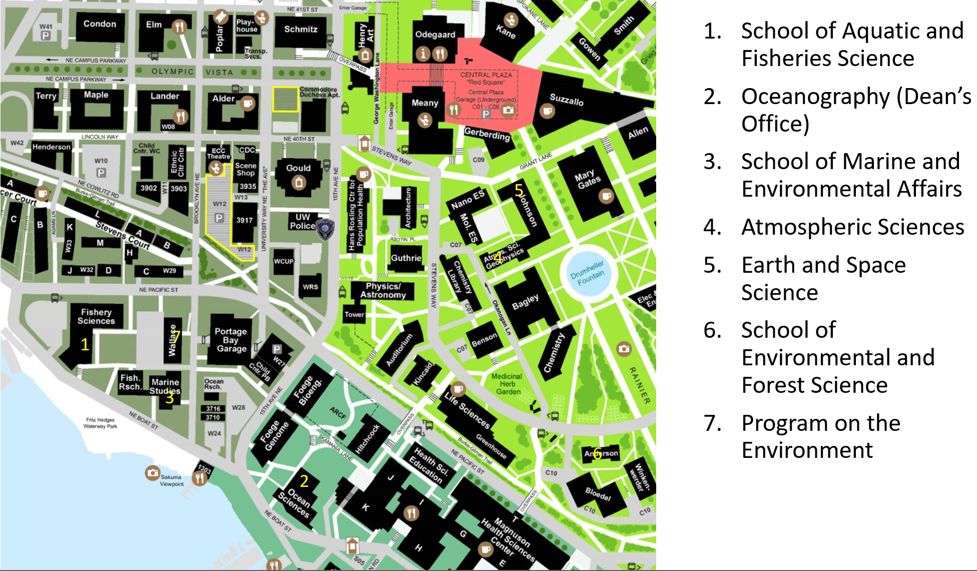
WHERE WE ARE

Slide 9
SCIENCE COMMUNICATION OPPORTUNITIES
Engage: Communicating Science to the Public Effectively (C ENV 500)
Applied Improvisation for Science Communication (C ENV 590)
John Meyer, Senior Director for Marketing and Communications
Notes:
A number of really great things to keep on your radar include special events and courses that are offered by the College. They include:
The ENGAGE course, which is called “Communicating Science to the Public Effectively”. It’s a Winter course developed and managed by grad students. Here you will learn about ways to improve your science communication, and have the opportunity to showcase your skills set in a special platform during Spring Quarter.
Next we have the Amplify series, which provides discussions with faculty, staff, postdocs and graduate students interested in science communication and outreach. Each discussion focuses on a particular challenge.
And finally, you will want to check out College and UW-sponsored, public lectures.

Slide 10
PROFESSIONAL DEVELOPMENT SERIES
2023-24 Pathways series
Autumn: Postdoc
Winter: Government
Spring: Industry
EPIC
DEI
Personal Development/Career tools
Notes:
Also throughout the year, we will host a series of professional and career development sessions and workshops that will provide advice or insight as you travel the pathways of your graduate education. Last year, we hosted one session each quarter on mentoring, resilience, and pathways to a postdoc. We’ll announce the autumn event topic soon.

Slide 11
FUNDING
Unit-level Scholarships & Funding
College Scholarships & Travel Awards
NSF Graduate Research Fellowship Program (NSF-GRFP)
Research Funding (Conservation Genetics, Big Data)
Grad Funding Information Service (GFIS)
Notes:
We are happy to let you know that we have a variety of funding opportunities available to you, as well. These include:
The quarterly Travel and Meeting Fund, where if you are presenting original research, you may apply for awards that fund to $750 for domestic travel and $1,000 for international travel. The Autumn Fund will open shortly, with a rolling deadline throughout the quarter. Be sure to check your email for more details.
We also provide generous funding if you are in areas of Genetic Conservation or Big Data. Applications for this annual award will be accepted during Winter Quarter. Be sure to watch for these announcements.
Other resources for funding, include the Graduate Funding Information Services, or GFIS, which is a service to you overseen by the Graduate School and the Library. You can make an appointment with an advisor there to research possible funding opportunities, that may include fellowships and scholarships.
As you think about future employment opportunities, be sure to check out our College Careers and Opportunities page on the College website. There you will find listings of the latest jobs that employers in environmental fields have posted with us.

Slide 12
TEACHING AND LEARNING
UW Center for Teaching and Learning
Teaching@UW: Strategies for TAs
Teaching Support Team
Notes:
Hopefully those of you who will be TAs or RAs this year, have had the opportunity to check out the RA/TA Conference sponsored by the Center for Teaching and Learning. CTL promotes student learning by supporting and strengthening UW teaching, focusing on evidence-based teaching, building global classrooms, and sustaining equitable learning communities.
CTL will also have online workshops on topics such as TA-ing in a lab setting or STEM quiz sections, maximizing student learning, available on Canvas until Oct 1.
The CoENV OTL team will also hold a College-specific TA training next week, please consider attending.

Slide 13
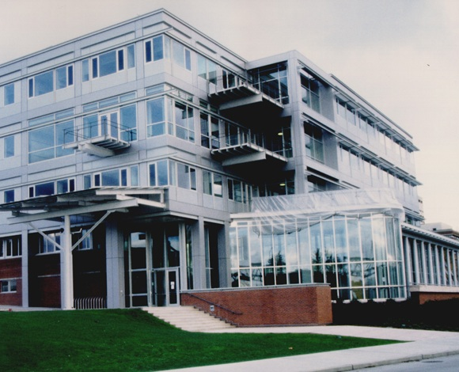
CONTACT INFO
coenvaa@uw.edu
Ocean Sciences Building (OSB), suite 200
Instagram: uw_environment_grads
environment.uw.edu/students/
Brandon Ray, Grad Student and Postdoc Scholar Specialist

Slide 14
OUR GUESTS TODAY
Graduate Student Affairs (UW Graduate School)
College of the Environment Teaching Support Team (TST)
College of the Environment Diversity, Equity, and Inclusion (DEI)
Disability Resources for Students
UAW 4121
Campus Police
College of the Environment Student Advisory Council (SAC)
Graduate & Professional Student Senate (GPSS)
Notes:
And again, I would like to thanks our campus partners for joining us today. You will hear a bit about each program this afternoon, before we finish up with a great graduate student panel discussion.

Slide 15
Graduate Student Affairs, The Graduate School
Jaye Sablan
Notes:
Some of the resources and means of connections can also be found at the Graduate School. Let me welcome Jaye Sablan from Core Programs in the Graduate School..
Thank you, Jaye for joining us!

Slide 16
Graduate Student Affairs
The Graduate School | University of Washington
Reflect, then share with 1-2 peers:
What’s one thing you’re looking forward to this quarter? (e.g. can be graduate study related, personal goal beyond academia, hobby, etc.)
Notes:
Intro. and prompt

Slide 17
Graduate Student Affairs
The Graduate School | University of Washington
Mission: Utilize a holistic approach to supporting UW graduate students through student-centered programming, timely resources, and intentional university partnerships.
Vision: Strive to promote the wellbeing of our diverse graduate student body, so they can thrive and be successful at the university and beyond.
Students We Serve:
Events are open to graduate students across disciplines
Equity & Inclusion: First-generation graduate students, International graduate students and collaborations with Graduate Student Equity & Excellence (GSEE) to support underrepresented minoritized grad students
Resources and Services:
1-on-1 consultations about navigating graduate student life
Grad student bulletin: tips for academic success, wellness, career development, and funding opportunities
Professional development events for grad students across disciplines

Slide 18
Graduate Student Success Programming 2023-2024
Offerings:
Fall & Winter - Practice your presentations skills at virtual and in person Scholars’ Studio events
Winter - Hone your career development skills at our career development retreats for PhD students in the Humanities, Social Sciences, Sciences & Engineering
Spring - Present a lightning talk on your research and compete for cash prizes at Three Minute Thesis
First-Generation Graduate Student Initiative:
Fall – Community Social; First-Gen Grad Student Welcome (as part of UW’s tri-campus recognition of National First-Gen Celebration)
Winter – Professional headshot event
Spring - End of Year Celebration

Slide 19
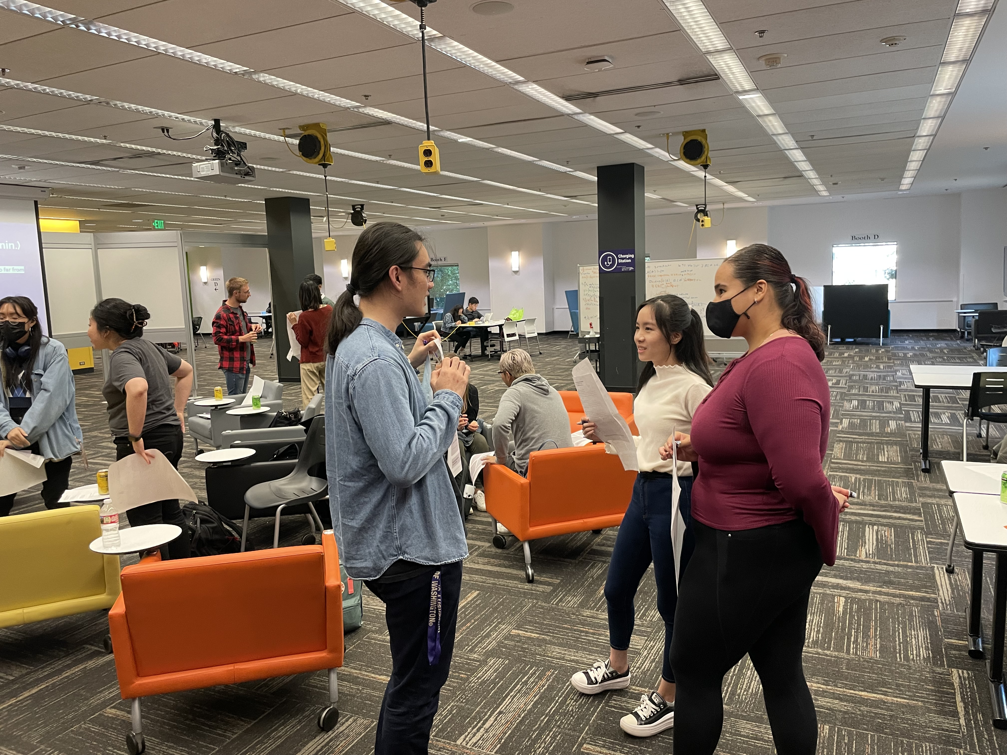
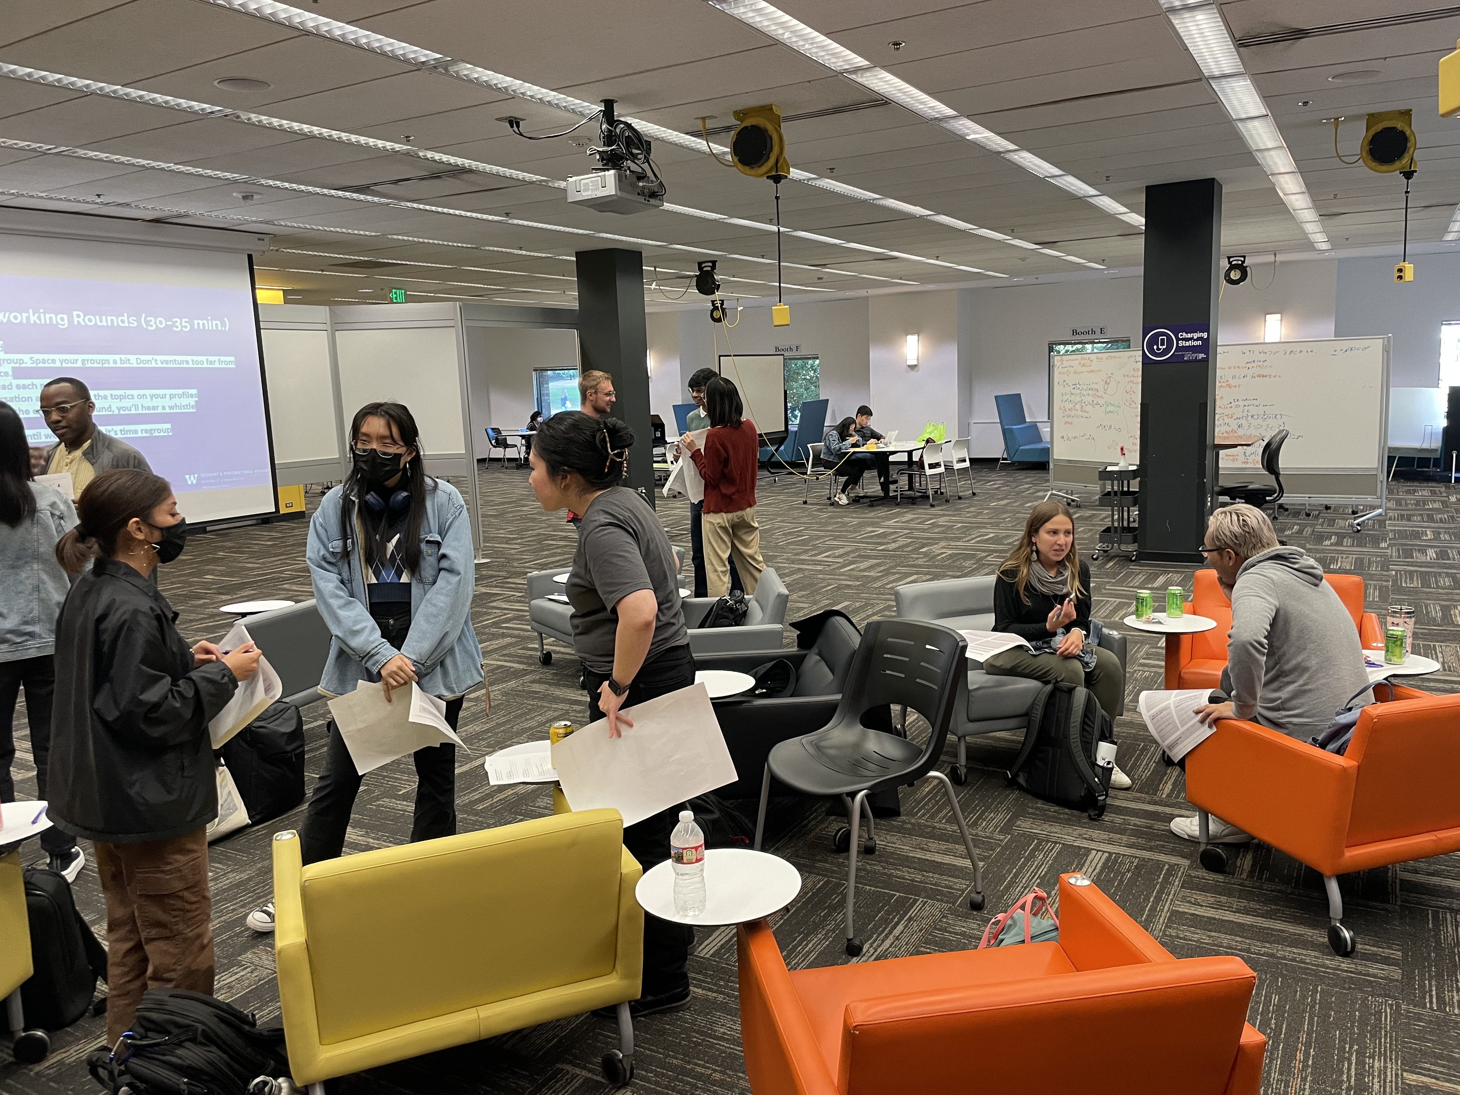
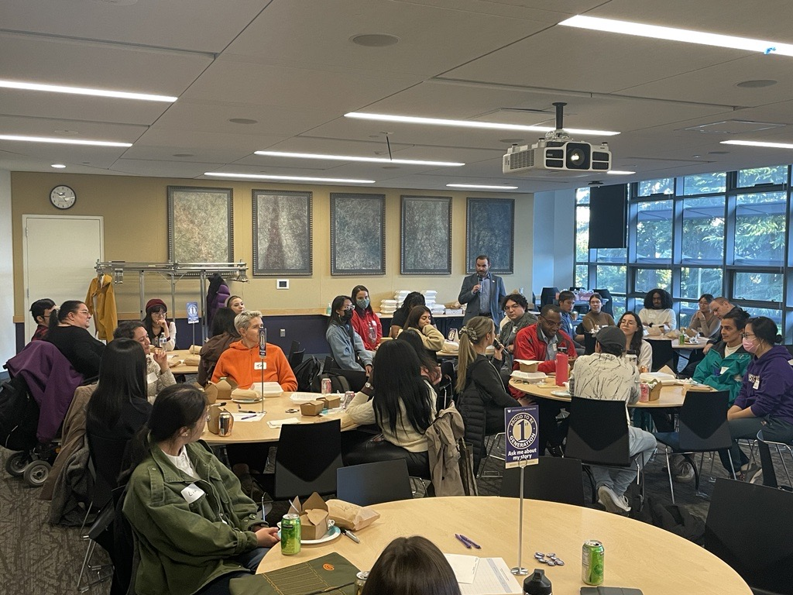
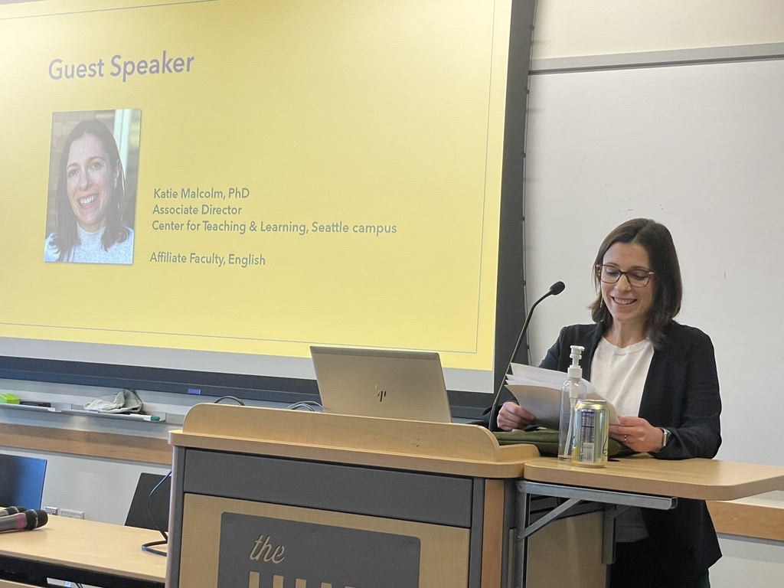

Slide 20
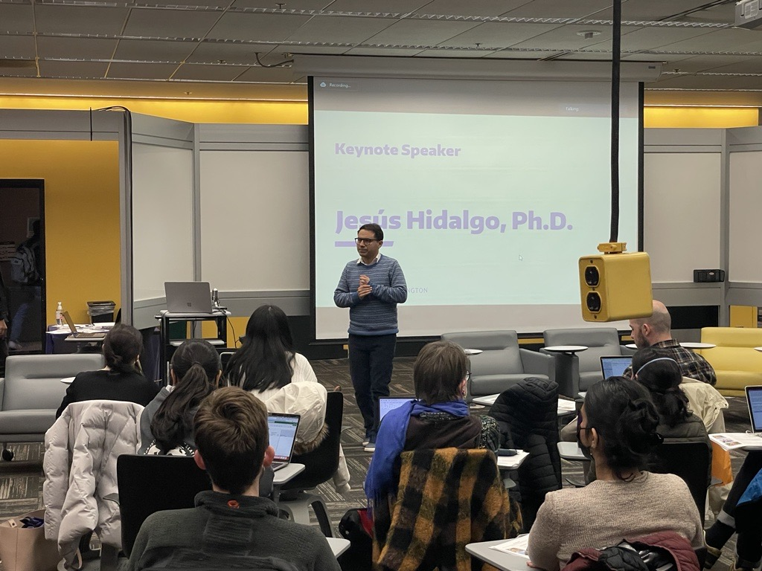
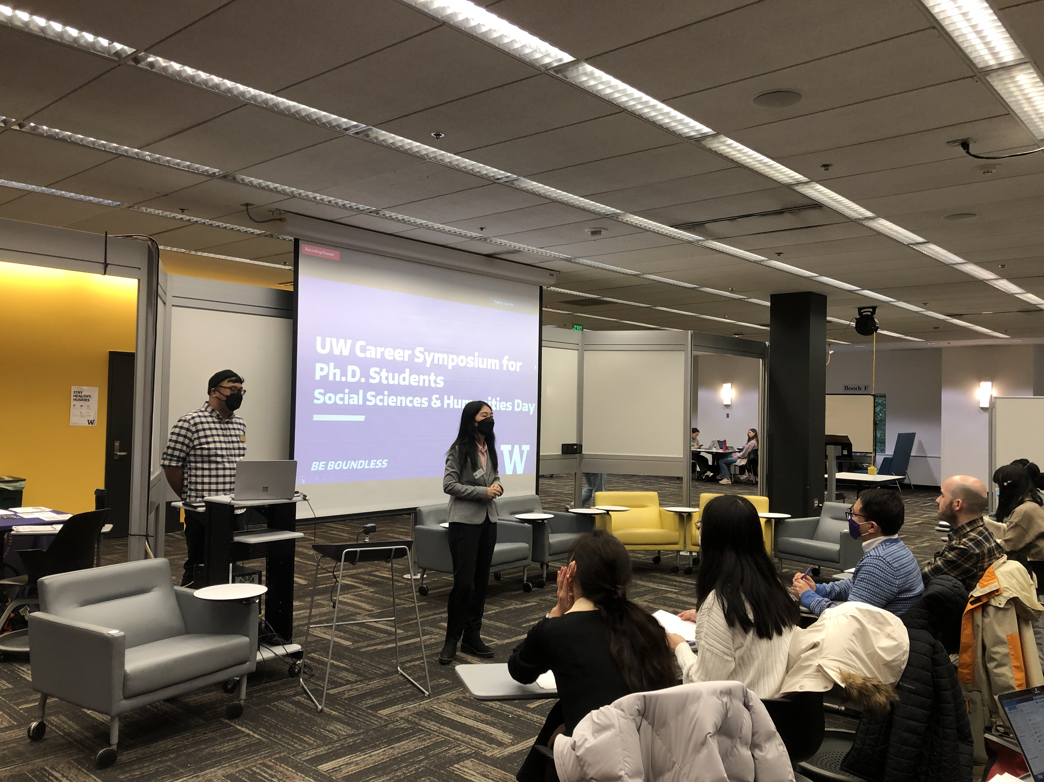
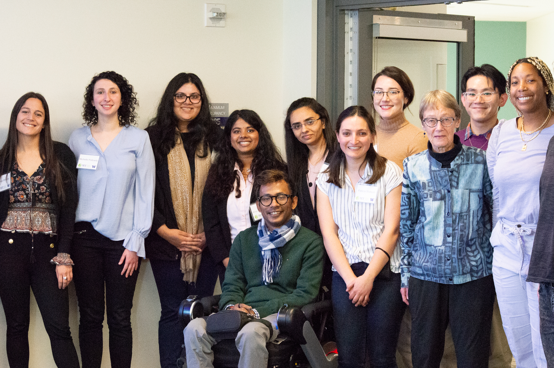

Slide 21
Campus Partners
UW Libraries Research Commons
Equity & Justice in Graduate Programs/ The Graduate School
Graduate Student Equity & Excellence/ The Graduate School
Center for International Relations & Cultural Leadership Exchange (CIRCLE)
Career & Internship Center

Slide 22
Graduate Student Affairs
The Graduate School | University of Washington
Reflect, then share with 1-2 peers next to you:
What types of support will you connect with to support your wellbeing and success? (campus resources, familial, community-based, faith-based, etc.)

Slide 23
Graduate Student Affairs
The Graduate School | University of Washington
Homepage: https://grad.uw.edu/directory_entry/graduate-student-affairs
Facebook: facebook.com/uwgradsa | facebook.com/groups/UWGradSuccess
Bill Mahoney PhD, Associate Dean of Graduate Student & Postdoc Affairs: wmahoney@uw.edu
Jaye Sablan MA, Assistant Director of Graduate Student Affairs: sablanj@uw.edu

Slide 24
College of the Environment Teaching Support Team (TST)
Kat Huybers
Notes:
Some of the resources and means of connections can also be found at the Graduate School. Let me welcome Jaye Sablan from Core Programs in the Graduate School..
Thank you, Jaye for joining us!

Slide 25
Teaching and TA-ing in the College of the Environment
Dr Kat Huybers (she/her/hers) Dept. of Atmospheric Sciences CoEnv Teaching Support Team

Slide 26
Why might you teach/TA as a graduate student?
Chat with your neighbor for a moment….

Slide 27
How can you learn more about/get help with teaching?
UW (Campus-Wide) Resources:
Center for Teaching and Learning (CTL)
https://teaching.washington.edu/
Online guides, workshops, one-on-one consultations
UW Information Technology: Teaching and Learning
https://itconnect.uw.edu/tools-services-support/teaching-learning/
Online guides , workshops, office hours, very helpful help desk (call, email)
Notes:
CTL offers: online resources for you to peruse on your own, workshops, one on one consultations
UW Information Technology has a branch dedicated to teaching and learning. In addition to guides on how to use Canvas (UW’s LMS), they also offer workshops, support for using other tech-related teaching tools (like poll everywhere). And resources that I use very frequently myself are: office hours for 2 hours/day (M-F) and you can call them or email and get help in a remarkably fast amount of time. They really do help you until it is figured out.

Slide 28
How can you learn more about/get help with teaching?
College of the Environment Resources:
College of Environment TA community: Listserv (a.k.a.: “Scholarly Snacks” find link on College of Environment teaching page, below)+ quarterly social events
Teaching Support Team – we are here to support you!
https://environment.uw.edu/intranet/teaching/teaching-resources/people/
coenvolt@uw.edu
Notes:
The college wants to foster a community of graduate students who are interested in and dedicated to great teaching. We have a listserv for all TAs, past present and future, which we encourage you to sign up for. Each quarter, there is also a social event to high five the end of the quarter.
We also have the …
The teaching support team, of which I am a member. This team consists of faculty that are dedicated to promoting teaching excellence throughout the college. This means supporting both other faculty and TAs! We offer workshops, one on one assistance with course planning or design, technology support, and

Slide 29
How can you learn more about/get help with teaching?
College of the Environment Resources (continued):
C ENV 555 Teaching Right: Best Practice Pedagogy in Environment Courses
1 credit, meets once a week
Designed to help students thrive in their teaching assistant positions and facilitate their growth into better instructors.
Offered: Autumn, Winter, Spring.
This Autumn: meets Fridays, from 2:30 – 3:30
Notes:
And finally, this is the second year that a class dedicated to maximizing yoru TA experience is being offered. It is called…

Slide 30
College of the Environment Diversity, Equity, and Inclusion (DEI)
Corey Garza
Notes:
Some of the resources and means of connections can also be found at the Graduate School. Let me welcome Jaye Sablan from Core Programs in the Graduate School..
Thank you, Jaye for joining us!

Slide 31
Disability Resources for Students
Ashley Walton

Slide 32
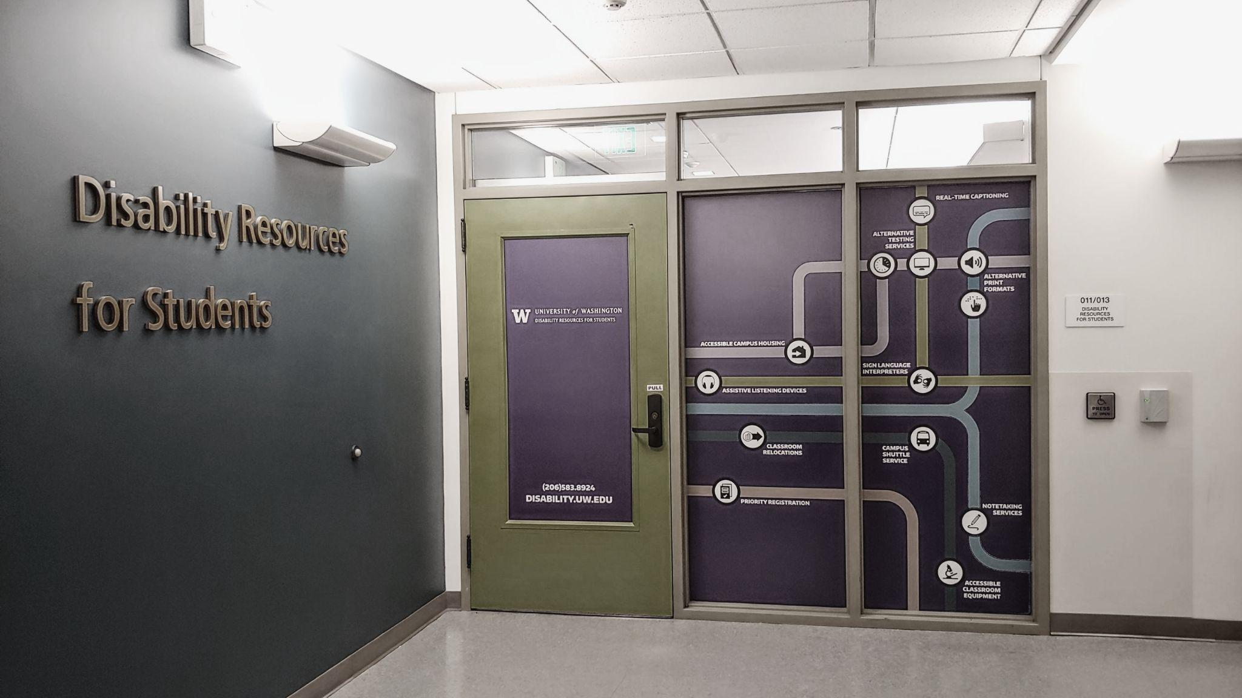
Disability Resources for Students (DRS)
Notes:
Image Description: Front entrance of Disability Resources for Students (Green/Purple door with colorful graphics covering the wall, various bubbles with icons like headphones, ASL Interpretation, transportation, etc.)

Slide 33
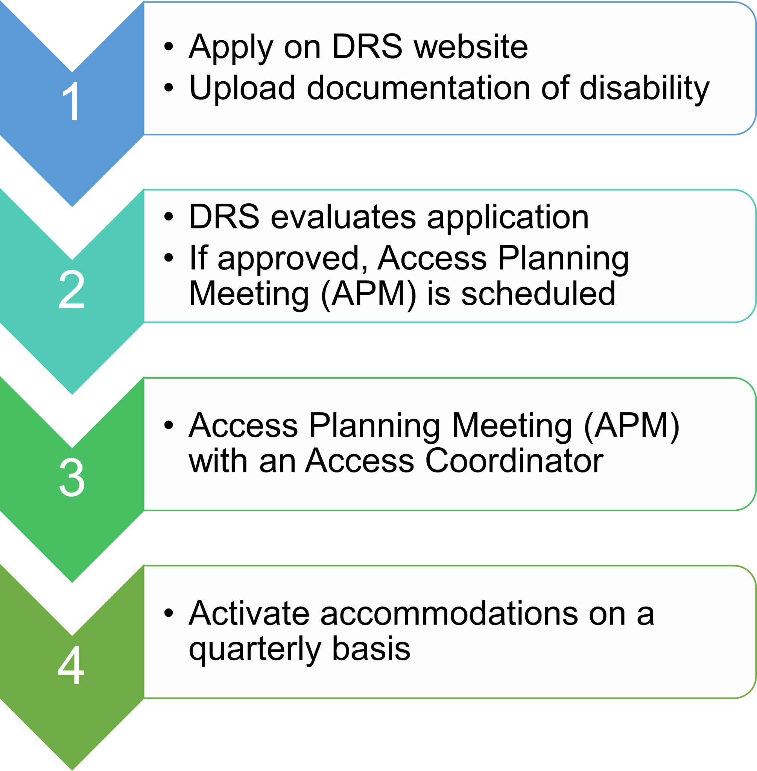
DRS Process
Notes:
Image description: Multicolored process tiles that read “1. Apply on DRS website, upload documentation of disability. 2. DRS evaluates application, if approved, Access Planning Meeting (APM) is scheduled. 3. Access Planning Meeting (APM) with an Access Coordinator. 4. Activate accommodations on a quarterly basis.”

Slide 34
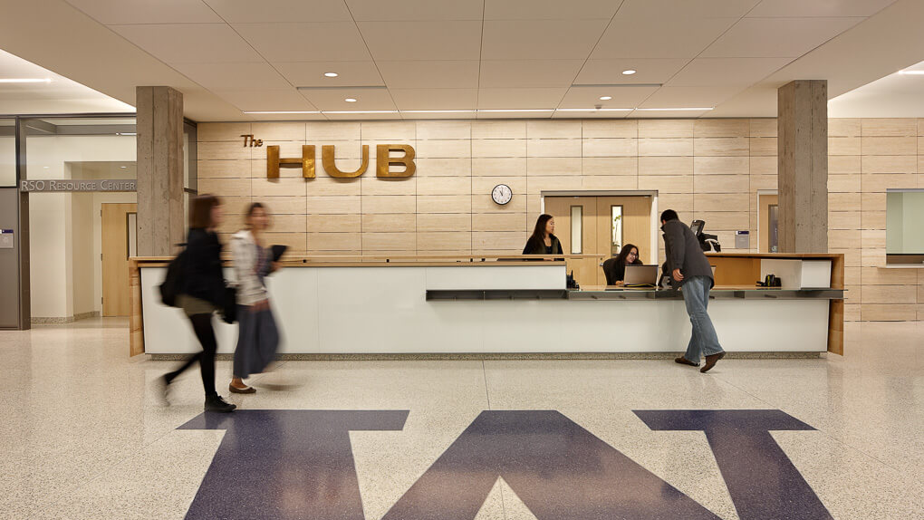
Contact DRS
ADDRESS
011 Mary Gates
Box 352808
Seattle, WA 98195-2808
PHONE
206-543-8924 (voice and relay)
EMAIL
uwdrs@uw.edu
WEBSITE
https://depts.washington.edu/uwdrs/
Notes:
Image description: Front desk of the Husky Union Building, with a big purple W on the floor

Slide 35
UAW 4121

Slide 36
Campus Safety
Chief Wilson

Slide 37
University of Washington Police Department
Safeguarding the Academic Community with PRIDE
Notes:
Thank you to the requestor.
Introduction: Name, Rank, Length of Service, Current Assignment

Slide 38
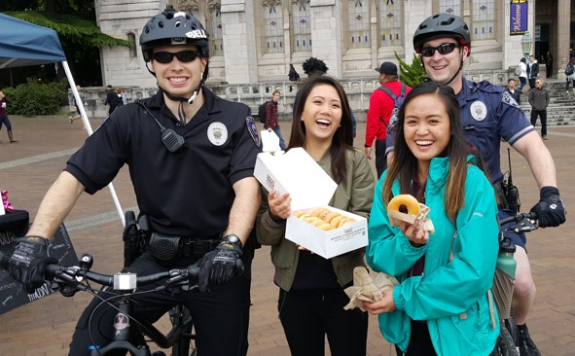
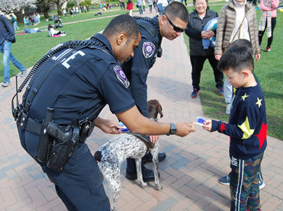
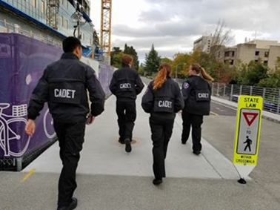
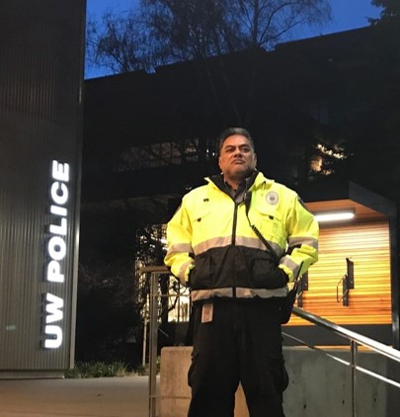
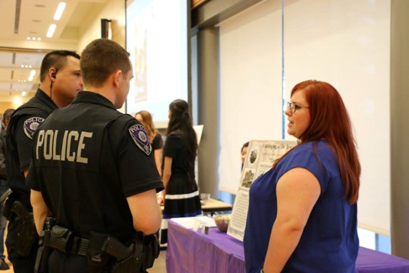
UW Police in the Community
Notes:
Goal of UWPD is to support you during this next stage of your life.
As UWPD we are here to help you transition from young adults living at home to responsible graduates living on your own.
It is important that you start learning to be accountable for your actions now while you have a support system set up to see you succeed.
Fully Commissioned CALEA Accredited LE Agency with full police powers
5th Reaccreditation (KCSO, WSP)
Outreach and involvement within our community and local LE partners – SPD areas like the AVE
CIT Training – resources available to our homeless community

Slide 39
UW Police Facts
Full service police department independent from Seattle PD
Open 24/7, 365 days a year
100% of Officers have attended the 40 hours Crisis Intervention Training (State only requires 8 hours)
All Officers are equipped with Tasers and less lethal force options
All marked patrol vehicles are equipped with recording devices
Two K-9 units are all Bomb/Explosive detection
UWPD is both state and nationally accredited law enforcement agency
WASPC (State)
CALEA (National)
Notes:
We are not SPD. We are independent yet work with SPD. Mention CIT training and K-9s.

Slide 40
Crime on Campus
2022 Crime Statistics
Property Crime
Arson – 5
Motor Vehicle Theft – 86
Burglary – 65
Theft - 536
Person Crime
Sexual Assault – 6
Agg. Assault – 6
Robbery - 2
Notes:
You are safe being a student here. Person on Person crime is relatively rare. You need to focus on Property based crimes while maintaining situational awareness for the person on person crimes.

Slide 41
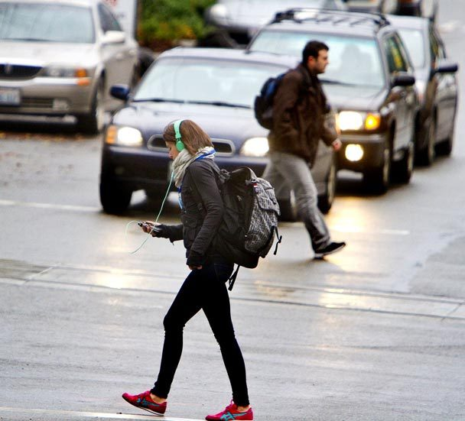
Be Alert
Notes:
Even though we emphasize keeping your property safe, your own safety is most important…

Slide 42
Personal Safety
>What is happening around me?
>Where am I, and where do I need to be?
>Is anyone or anything a threat to my health and safety?
Start with situational
awareness
Notes:
Encourage the students that safety starts with you!
We are here to support and assist you; however only you can take ownership of your personal safety.

Slide 43
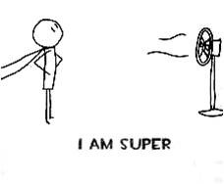
Personal Safety
>Wherever you are, stay ‘tuned-in’ to your surroundings.
>Trust your instincts. If something or someone makes you uneasy, get out or go a different direction - Follow your ‘gut’ reaction.
>Show confidence - be aware and in control. Body language works.
Situational awareness

Slide 44
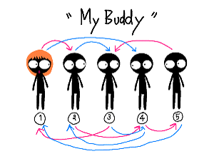
Personal Safety
>Use the ‘buddy system.’
>Stay in well-lit, well-traveled areas.
>No shortcuts through wooded areas, parking lots or alleys.
Practical Advice

Slide 45
Financial Security &
Identity Theft
>No law enforcement agency calls individuals seeking payment for fees over the phone nor do they accept gift cards as payment for such fees.
>No law enforcement agency calls individuals and demands money under any circumstances or threaten to arrest or deport you for not paying.
>Do not willingly give up your personal information to anyone over a phone conversation or email. Do not open attachments!
Scams, Phishing, and Social Engineering

Slide 46
Financial Security &
Identity Theft
>Any official correspondence will be in letter format, through certified mail with official agency letterhead or face-to-face contact.
If you are in doubt about any email, phone call, or letter…contact the UWPD!
Scams, Phishing, and Social Engineering

Slide 47
Protect Your Property
>Register your property with a serial number
–Electronics: http://police.uw.edu/ereg/
–Bicycles: https://bikeindex.org/uw
>Lock or secure it properly
>Report suspicious activity
police.uw.edu/loveyourstuff
Notes:
Encourage females to register for the RAD program

Slide 48
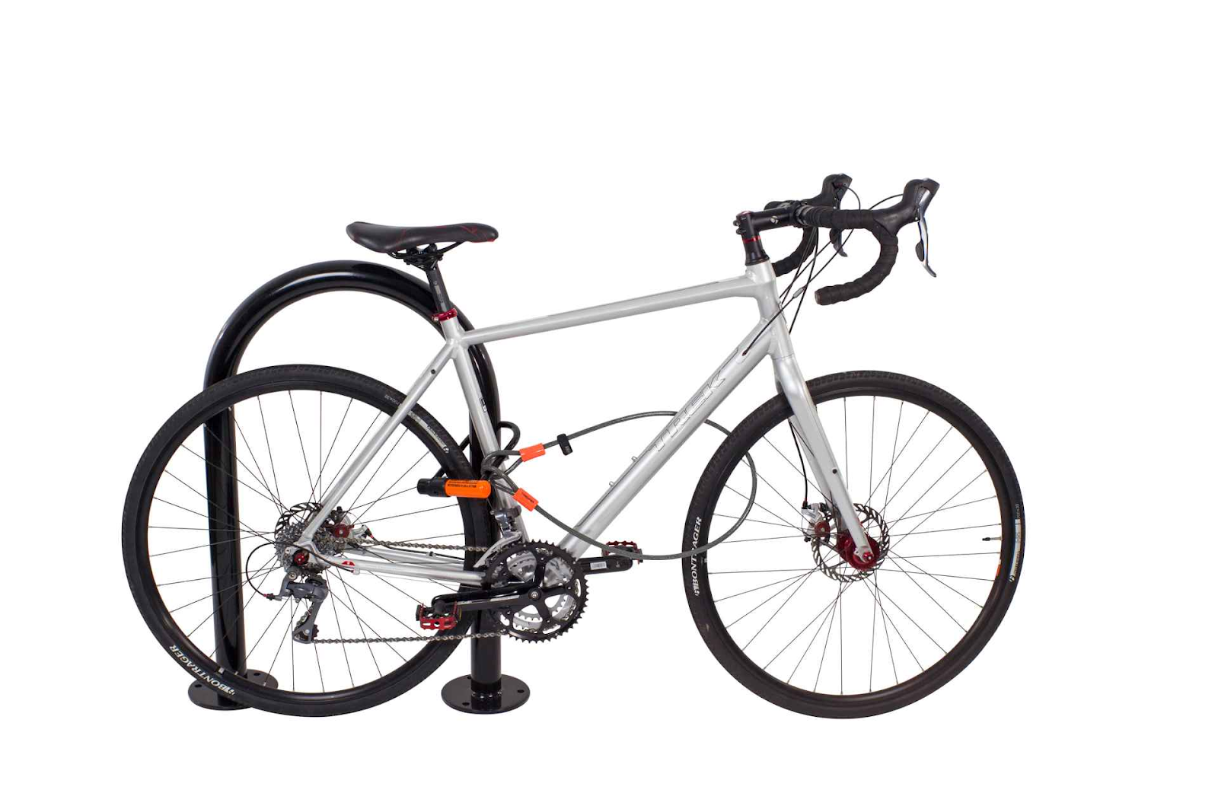
Bicycle Security
Best Practices at the Racks
Use a U-Lock with a chain lock.
Lock both wheels to the frame and the rack with the chain lock.
Lock the wheel without quick release to the frame and the rack.
Never use a cable lock alone. Seriously...it’s bound to get stolen.
Notes:
The best way to lock up your bike is with a U-lock combined with a chain lock. Pictured here is a cable lock which is better than nothing.

Slide 49
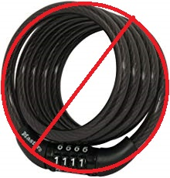
Bicycle Security
Did we mention never using a cable lock alone? That’s right...we did.

Slide 50
Safety Programs
> Husky NightWalk:
206.685.9255
> Confidential Advocates:
lwadvoc@uw.edu
> Community Engagement:
engagepd@uw.edu
SafeZone App:
https://police.uw.edu/safezone-app/
Notes:
Encourage females to register for the RAD program

Slide 53
UW Alert
>UW Alert: www.uwalert.org
–SMS text, email
>Timely Warnings
–Notification of Criminal Incidents

Slide 54
Contacting Us
Emergencies: 911
from a cell phone, ask to be transferred to UWPD
> Code Blue Phones or Yellow Call Boxes
> Non-emergencies:
206.685.UWPD (8973)
> Anonymous Tips:
206.685.TIPS (8477)
> General Email:
uwpolice@uw.edu
> Events/Outreach: engagepd@uw.edu
> Husky NightWalk: 206.685.WALK (9255)
Follow Us on Social Media!
Free giveaways and prizes!
@UW_Police
Notes:
Open the floor to questions.
If there are questions (non-emergent), encourage to visit UWPD at our website and Facebook, and use the UW Police email for general questions.

Slide 55
College of the Environment Student Advisory Council (SAC)
Zachary Bengtsson

Slide 56
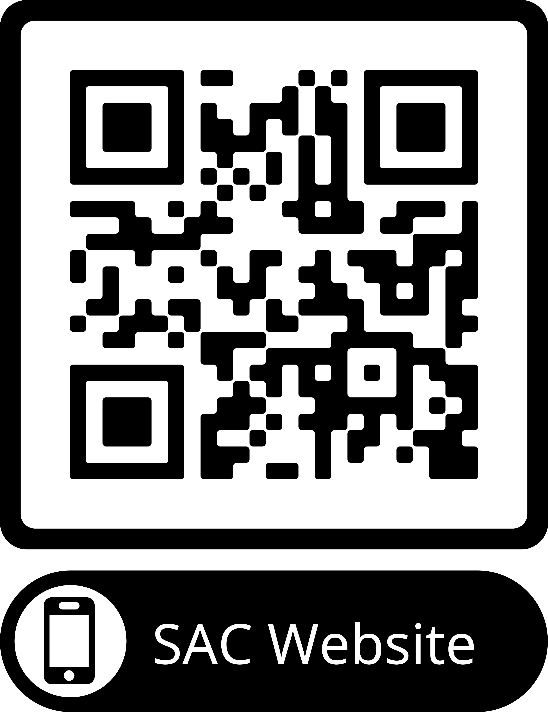
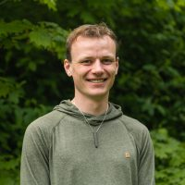
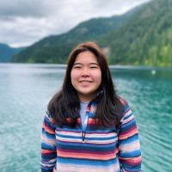
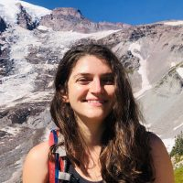
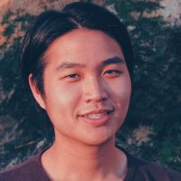
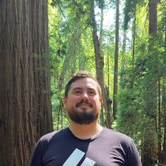
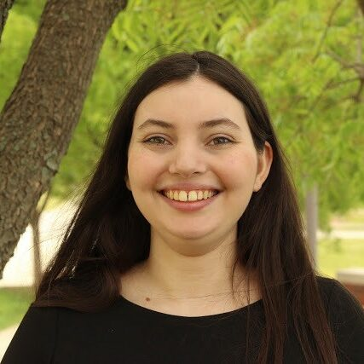
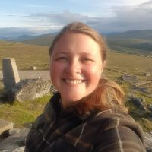
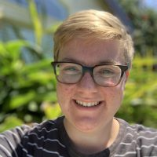
CoENV Student Advisory Council Graduate Representatives
Alec Solemslie
SEFS
Aina Hori
SMEA
Emma Heitmann
ESS
Terrance Wang
SAFS
Zach Bengtsson
SAFS (co-chair)
Ariel Jacobs
ATMOS
Katy Christensen
OCEAN
Zoe Rand
QERM

Slide 57
Graduate and Professional Student Senate
Jack Flesher

Slide 58
UNIVERSITY OF WASHINGTON
Graduate and Professional
Student Senate
Notes:
Thank you all so much for being here, and thank you to the [DEPARTMENT/PROGRAM NAME] for this opportunity to speak to you all. My name is _____________ and I’m a student in [PROGRAM] and a/the [GPSS POSITION]. Today, I am excited to introduce you to the Graduate and Professional Student Senate, or GPSS.

Slide 59
WE ADVOCATE for the needs and interests of our constituents WE PROMOTE professional development and foster a sense of community and connection WE AMPLIFY graduate and professional student voices and experiences WE ASPIRE to eradicate inequities existing within institutionalized academic settings
ABOUT GPSS
Notes:
So what are we, what do we do, and why should you care about us? GPSS is the governing body that services the needs and interests of over 16,000 graduate and professional students at the University of Washington, representing a crucial piece of the University’s shared governance system: WE ADVOCATE for the needs and interests of our constituents on campus and at the state and federal levels. WE PROMOTE professional development and foster a sense of community and connection through our events, programming, and funding opportunities. WE AMPLIFY graduate and professional student voices and experiences to ensure our shared values are upheld at all levels of university decision-making. WE ASPIRE TO ERADICATE inequities existing within institutionalized academic settings that inhibit an equitable, inclusive community within the university.

Slide 60
Senators
Officers
UW Graduate & Professional
Students
Executive Senators
Staff
Liaisons
Notes:
To accomplish these, we have built a dedicated, talented, and fun team. At our core, GPSS is comprised of UW graduate and professional students, whose needs and interests we represent. Our Senators, two from each degree program, make up the Senate body itself. These include our seven Executive Senators, who are elected to our Executive Committee, which also is home to our six elected Officers: the President, Vice President of Internal Affairs, Vice President of External Affairs, Vice President of Equity and Inclusion, Vice President of Administration, and Vice President of Finance. We are all supported by the nine staff members we employ. Finally, we have GPSS liaison positions for graduate student to be appointed to University-wide boards and committees.

Slide 61
Funding
Committees
What GPSS does:
Advocacy and Lobbying
Events
Appoint Liaisons
Notes:
Funding: Travel Grants ($300 Domestic/$500 International), Diversity Funds (up to $500), Departmental Allocations (Up to $1000), and Special Allocations to support RSOs (Up to $750)
Advocacy and Lobbying: In addition to the work done in Senate, GPSS creates a legislative agenda, and lobbies at state and federal levels for the values and needs of graduate and professional students (Legislative issues survey!, LAB, Legislative Reception, Grad Day on the Hill, and WSA).
Committees: GPSS currently has 9 committees (6 open to all graduate students and 3 open only to Senators). More on these in a moment!
Appoint Liaisons: GPSS appoints graduate and professional students to University-wide boards and committees, and offers them support and networking to make sure that graduates students are represented at all levels of decision making and that the information gained there is communicated back to graduate students.
Events: GPSS hosts many events throughout the year, both professional and social, geared towards improving the quality of life for graduate students and creating spaces and opportunities for community.

Slide 62
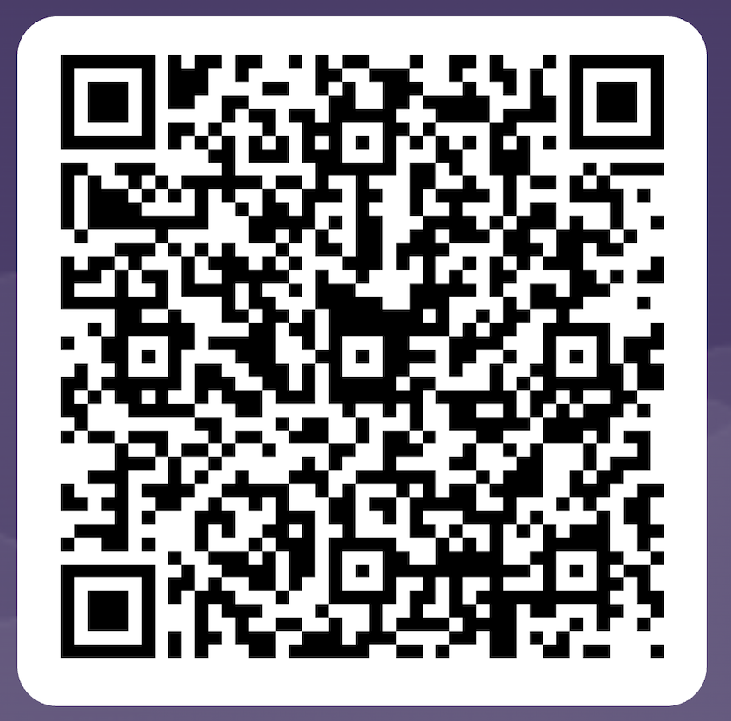
2023-2024 Legislative Interest Survey
Notes:
Every year, GPSS conducts a survey to guide the Legislative Agenda to make sure that we are advocating for the causes and issues about which graduate and professional students care. Please take a moment to fill out our 2023-2024 Legislative Interest Survey.

Slide 63
Notes:
One upcoming event is a GPSS collaboration with UW Athletics for the upcoming football game on 9/23 against the California Golden Bears. We have a section of reserved tickets at a lower cost available to students and their families and friends. If you're interested, please scan this QR Code!

Slide 64
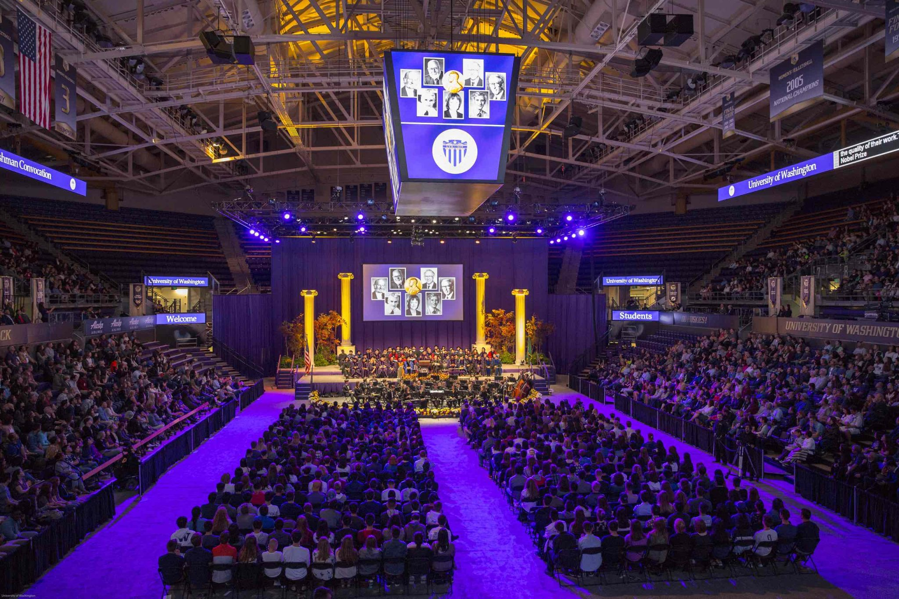
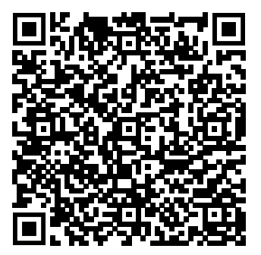
UW New Student Convocation
September 24
1:30-2:30PM PST
Alaska Airlines Arena
Sign-Up with this QR Code
and
please remember to use the event code “23GRAD”
Notes:
Another event you can consider as an incoming graduate student is attending the UW New Student Convocation on September 24th, from 1:30-2:30. Convocation does require pre-registration, which you can complete using this QR code link to the form. When you sign up, please remember to use the event code “23GRAD”.

Slide 65
COMMITTEES
Legislative Advisory Board (LAB)
Diversity Committee
Science & Policy
Travel Grants
Arts Council
Committee for Senators Motivation and Retention (CSMR)
Judicial
Elections
Finance & Budget
*Highlighted committees are only open to GPSS Senators
Notes:
Our GPSS Committees play a vital role in the functioning of GPSS, as well as representing an opportunity for wider graduate student involvement than just Senate. We rely heavily upon willing and committed graduate and professional students who want to make an impact to join our various committees because of this. Outside of the three highlighted, these committees are open to all graduate and professional students: The Legislative Advisory Board (LAB) develops the aforementioned Legislative Agenda ahead of Winter Quarter’s legislative session in Olympia and assists with lobbying, advocacy, and student organizing efforts. The Diversity Committee awards diversity funds and collaborates with other campus diversity events and programs, as well as developing their own. This Committee is being reinforced and restructured to better reflect the importance of this work, and we appreciate feedback on how it should continue to support students. The Science & Policy Committee enhances the discourse between scientists and policy makers through advocacy and student empowerment.
The Travel Grant Committee allocates $25,000 in travel grants to graduate students for participation in academic/professional conferences. The Arts Council advocates specifically for the arts and humanities, which are not always a priority in university discussions and decision-making. Likewise, it fosters a community of support and collaboration among graduate students in the arts and humanities.
The Committee for Senators Motivation and Retention (CSMR) is a new committee whose mission is to find ongoing and relevant ways to motivate Senators, promote Senator retention, and recognize Senators’ work in GPSS.
The Committees only open to GPSS Senators include: The Elections Committee, which oversees the elections process for next years Officers in Spring Quarter, the Finance & Budget Committee, which develops the annual GPSS Budget and oversees Departmental and Special Allocations, and the Judicial Committee, which investigates and manages grievances concerning the internal workings of GPSS such as compliance with our Constitution or Bylaws and grievances against Officers or Senators.

Slide 66
GPSS Senate Meetings are Every Other Wednesday @ 5:30PM in HUB 332
(and via Zoom)
ALL ARE WELCOME!
October 4: OPEN HOUSE: 3-5PM (PST), GPSS OFFICE (HUB 314)
October 18: First Senate Meeting: 5:30-7:30, HUB 332
Notes:
Our GPSS Meetings are every other Wednesday and open to the public, just like our Committees. Meetings will be on Zoom presently: they are normally in the HUB. These are the primary settings we conduct official business, such as passing resolutions on behalf of graduate and professional students. We will have a GPSS open House on October 4 from 3-5 in the GPSS Office (HUB 314), and our first meeting will be October 18th and designed to be approachable for those with no student government experience. You’re always welcome at these meetings, you’re always welcome at GPSS. In the words of our President: “Come as you are; you belong here; you are enough.”

Slide 67
HOW TO GET INVOLVED
Attend Senate Meetings
Become a Liaison
Join a GPSS Committee
Become a Senator
Attend Events
Notes:
If any of what I have described today aligns with your interests and values, I invite you to join us! Please, please reach out. We will get you plugged in. To recap, the ways you can get involved are: Attending Senate Meetings, which are hosted every other Wednesday at 5:30PM;
Becoming a Liaison, representing graduate and professional students on University committees, groups, and boards, which you can contact A.J. Balatico, the GPSS President, about;
Joining a GPSS Committee, with the Legislative Advisory Board, Diversity Committee, Science and Policy, Travel Grants, and Arts Council being open to all students; Becoming a Senator, which is something you can speak with your Graduate Program Advisor or Jack Flesher, the GPSS VP of Administration (gpssvpadmin@uw.edu), about, including if you do not know who your Senators are;
And Attending Events, with a variety opportunities throughout the year.

Slide 68
CONTACT AND FOLLOW US
Website: gpss.uw.edu | Email: gpss@uw.edu
Phone: (206) 543-8576
Facebook: UWGPSS | Instagram: @gpssuw | Twitter: @uw_gpss
Notes:
Please feel free to reach out to us at anytime! We will continue to update our website with information on our events, resources, and opportunities, as well as our social media accounts.

Slide 69
Campus Partners
Graduate Student Equity and Excellence (GSEE)
STEM Pals
ENGAGE
oSTEM

Slide 70
THANK YOU
Welcome to the University of Washington!
Notes:
Closing points:
• Snacks, beer, cider, soda, water - please grab and go and do not congregate around food/drink stations. Eat/drink outside only
• Icebreaker activity: meet your peers
o Signage: things about you and different conversation prompts are taped on windows outside lobby and on posters on lawn
o Keep groups small (4-5 people)
o we’ll start in 10 minutes - rotate to a new station every 5 mins when you hear the bell

