Slide 1
Operating fee revenue distribution calculations for ABB

Slide 2
Agenda
Roadmap for data/tool development
Steps to calculate tuition revenue pools
Steps to calculate distribution of revenue to units
Summary of approach to making projections
Questions of clarification only, please
All questions are welcome!
Additional questions

Slide 3
Roadmap for ABB information development
Data are now available in AIDB (in EDW) that allow everyone to see and perform all of the operating fee revenue distribution calculations for ABB.
From now until the end of the FY, we will be developing tools that make it easier to take advantage of the data
First, SQL code and Access queries that do specific things.
Later, more user-friendly tools
Notes:
As most of you know, we committed to getting the data out by end of calendar year, with an emphasis on tool development from now until end of FY.
Daniel Summy in OPB did first round of development of tables to support these calculations
Table design, sourcing turned over to EIIA ( Enterprise Information, Integration & Analytics ) team to put into production in AIDB in EDW
Fact that it’s in AIDB means:
Transitional space
Not full production environment (24/7), not optimized, etc.

Slide 4
What is available now?
Sixteen new tables
Ten required for ABB calculations
One additional table will facilitate projections
Detailed information can be found here

Slide 5
There are three basic sets of calculations required for tuition in ABB
Calculation of net operating fee revenue pools for each tuition group
Calculation of the distribution of each tuition group’s revenue pool to each school/college
Projections for future years

Slide 6
Calculating Net Operating Fee Revenue Pools by Tuition Group

Slide 7
One preliminary detail: tuition codes, categories, groups
Detail is in OPB_TuitionCodeCategoryGroup
Tuition Campus | Tuition Code | Tuition Code Name | Tuition Category Name | Tuition Residency Name | Tuition Group Name
0 | 100 | Seattle, Resident, Undergraduate | Undergraduate | Resident | Undergraduate
0 | 101 | Seattle, Nonresident, Undergraduate | Undergraduate | Nonresident | Undergraduate
0 | 105 | Seattle, Resident, Post-baccalaureate taking only UG courses | Undergraduate Post-Bacc / Non-Matric | Resident | Undergraduate
0 | 106 | Seattle, Nonresident, Post-baccalaureate taking only UG courses | Undergraduate Post-Bacc / Non-Matric | Nonresident | Undergraduate
0 | 108 | Seattle, Resident, Non-matriculated taking only UG courses | Undergraduate Post-Bacc / Non-Matric | Resident | Undergraduate
0 | 109 | Seattle, Nonresident, Non-matriculated taking only UG courses | Undergraduate Post-Bacc / Non-Matric | Nonresident | Undergraduate
0 | 200 | Seattle, Resident, Graduate Tier I | Graduate Tier I | Resident | Graduate Tier I
0 | 201 | Seattle, Nonresident, Graduate Tier I | Graduate Tier I | Nonresident | Graduate Tier I
0 | 203 | Seattle, Resident, Graduate Tier II | Graduate Tier II | Resident | Graduate Tier II
0 | 204 | Seattle, Nonresident, Graduate Tier II | Graduate Tier II | Nonresident | Graduate Tier II
0 | 208 | Seattle, Resident, Graduate Tier III | Graduate Tier III | Resident | Graduate Tier III
0 | 209 | Seattle, Nonresident, Graduate Tier III | Graduate Tier III | Nonresident | Graduate Tier III
0 | 220 | Seattle, Resident, Post-baccalaureate/Non-Matric taking any graduate course | Graduate Post-Bacc / Non-Matric | Resident | Graduate Tier III
0 | 221 | Seattle, Nonresident, Post-baccalaureate/Non-Matric taking any graduate course | Graduate Post-Bacc / Non-Matric | Nonresident | Graduate Tier III
0 | 435 | Seattle, Resident, Master of Education & Master in Teaching | Master of Education and Master in Teaching | Resident | Education Graduate
0 | 436 | Seattle, Nonresident, Master of Education & Master in Teaching | Master of Education and Master in Teaching | Nonresident | Education Graduate
0 | 432 | Seattle, Resident, Doctor of Education & Education PhD | Doctor of Education and Education PhD | Resident | Education Graduate
0 | 433 | Seattle, Nonresident, Doctor of Education & Education PhD | Doctor of Education and Education PhD | Nonresident | Education Graduate
Notes:
Students are identified in EDW by Tuition Code.
Every TuitionCode can be translated to a particular Tuition Campus, Category, and Residency
Regents approve tuition rates by Tuition Campus, Category, and Residency
In the past, we have published tuition revenue information by tuition group

Slide 8
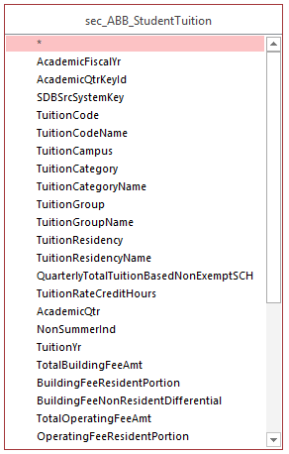
First: Find total amount of operating fee charged
Use ABB_StudentTuition
One record per student per quarter
Shows:
Tuition campus, category, group, and residency
Amount charged, given census day enrollment, for each fee
You want operating fee and resident portion of operating fee
Remember that ABB applies only to Fall, Winter and Spring quarters

Slide 9
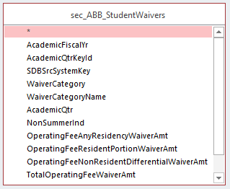
Second: Determine total amount waived
Use ABB_StudentWaivers
One record per student per quarter per waiver category
Shows TotalOperatingFeeWaiverAmt
Also, needed for projections, waiver of :
Resident portion
Nonresident differential
Op fee regardless of residency
Notes:
Waiver Categories:
TA/RA Resident, NR Differential
ICA Gender Equity
WWAMI, WICHE
Over 18
International Exchange
Active Military, Vet, Depend
Etc.

Slide 10
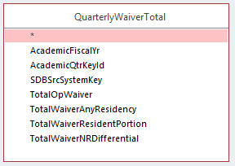
Second (cont.) Sum waivers over waiver categories
To make things easier, sum waiver amounts over categories (unless you want to explore amount associated with each waiver type)
(This will make things easier because you will have one record per student with op fee charges and one record per student with amount waived)

Slide 11
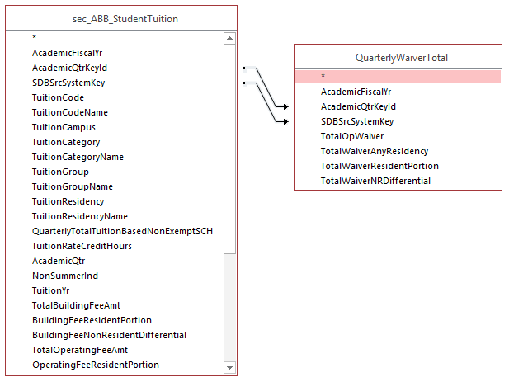
Third: Combine amount charged with waivers
Need a “left join” because not every student receives a waiver
Output:
Gross revenue
Gross revenue – resident portion
Amount waived

Slide 12
Third (cont.): Finish calculating net revenue
For each tuition group, we now have:
$$G=Gross Revenue$$
$$G_{R}=Gross revenue, resident portion$$
$$W=Waivers$$
Calculate aid pools:
$$NM=Need merit pool=0.04×G_{R}$$
$$S=SetAside=0.05×\left(G−W−NM\right)$$
Calculate net revenue:
$NetOp=G−W−NM−S−Addl,$ where
$Addl=Additional Aid Pool$ (from OPB_AdditionalAidPool)

Slide 13
Fourth: Calibration
There is a difference between the amount of revenue we calculate and the amount we receive because:
We calculate gross revenue based on census day enrollment
People may not pay in the quarter in which they are enrolled; people from prior quarters may pay in this quarter
For purposes of calculating true-up, we do calibration, which is detailed in the documentation, SQL, and Access.
Calibration factors are usually around 0.995, so it is not necessary to use the calibration factor when doing projections.

Slide 14
Calculating the distribution of net revenue from each tuition group that will go to each school/college

Slide 15
Current rules
70% of net operating fee revenue is distributed to units
Undergrad:
80% SCH, 20% degree majors
Grad/Professional:
80% SCH, 20% major enrollments
Notes:
Simply multiply out, and you will find distribution

Slide 16
Net op fee revenue from each tuition group
Undergrad
Grad (PhD)
MD
Engineering Masters

Slide 17
70 % of Net revenue pools
Undergrad
Grad (PhD)
MD
Engineering Masters

Slide 18
Distribution of each pool
College 1
College 2
College 1
College 3
College 2
College 3
College 2
College 1
College 1
College 3
College 2
College 3
Undergrad
MD
Grad (PhD)
Engineering
Masters

Slide 19
Amount to each school/college
Engr Masters
Grad (PhD)
MD
Undergrad
Engr Masters
Grad (PhD)
MD
Engr Masters
Grad (PhD)
Undergrad
MD
Undergrad
College 1
College 2
College 3

Slide 20
SCH for each Tuition Group from Each Unit
Use ABB_StudentTuition, ABB_CourseSectionRegistrations, and ABB_CurriculumFinancialOrganizations
One record per student per quarter – tells us a student’s tuition group
One record per student per quarter per course registration (tells us # SCH by curriculum for each student)
One record per AFY per curriculum to department mapping (tells us which department(s) a curriculum maps to).
Notes:
Again, we do that on the basis of SCH, major enrollments, and degree majors

Slide 21
% SCH
First get # SCH for each tuition group from each school/college (SCH)
Sum total SCH for each tuition group (TotSCH)
Calculate % SCH for each tuition group from each college (SCH/TotSCH)

Slide 22
% Major Enrollments (grad/prof only)
Use ABB_StudentTuition, ABB_GraduateMajorProgramEnrollments, and ABB_MajorFinancialOrganizations
One record per student per quarter – tells us a student’s tuition group
One record per grad/prof student per major enrollment.
One record per AFY per major to department mapping (tells us which department(s) a major maps to).
Notes:
Same process – calc # major enrollments for each TG from each school college
Calculate total for each TG
Calc %

Slide 23
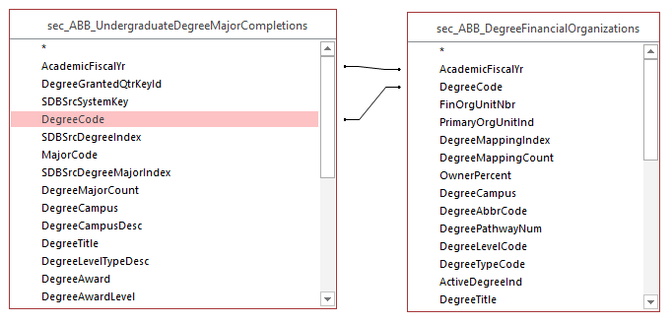
% Degree Majors (undergrad only)
Use ABB_UndergraduateDegreeMajorCompletions and ABB_DegreeFinancialOrganizations
One year lag:
That’s why code includes ABBYr
One record per student, bachelor’s degree, and major
One record per AFY per degree major to department mapping (tells us which department(s) a degree maps to).
Notes:
Same process – calc # degree majors from each school college
Calculate total degree majors
Calc %

Slide 24
Projection basics

Slide 25
Projection basics
You may wish to look at two things:
The likely effect of enrollment changes or tuition rate changes on the net revenue pool for a given tuition group, or
The likely effect of increasing your unit’s SCH production, degree majors, or major enrollments
Note that these things are potentially related
Are you expecting an increase in enrollment in a given tuition group that will increase majors or SCH, or
(Undergrads) will your increase in degrees or SCH mean a reduction for another school/college?

Slide 26
Effect of enrollment or tuition changes on revenue pool
Do calculation separately for each tuition category and residency combination. You will need to know:
$∆E=\% change in enrollment for tuition category, residency$
$$∆T_{g}=\% change in tuition for tuition category,residency$$
$$∆T_{r}=\% change in resident portion of tuition for tuition category,residency$$
$$∆T_{n}=\% change in nonresident differential for tuition category, residency$$
$$G=gross operating fee revenue in base year for tuition category, residency$$
$$G_{r}=gross operating fee revenue, resident portion$$
$$W_{g}=waivers in base year applied to operating fee, regardless of residency$$
$$W_{r}=waivers applied to resident portion of operating fee$$
$$W_{n}=waivers applied to nonresident operating fee differential$$
Given these values, calculate the values given enrollment and tuition changes as:
$$G^{′}=new gross revenue=G×(1+∆E)×(1+∆T_{g})$$
$$G_{r}^{′}=new gross resident revenue=G_{r}×\left(1+∆E\right)×\left(1+∆T_{r}\right)$$
$$W=new total waiver=(1+∆E)×(W_{g}×\left(1+∆T_{g}\right)+W_{r}×\left(1+T_{r}\right)+W_{n}×(1+∆T_{n})$$
Now you can calculate the need/merit pool, set-aside, and net revenue as before.
Lever
Lever
IV_AnnualFullTimeTuitionSchedule
will be useful
Lever
Lever
Known
Known
Known
Known
Known
(Note that it is unknown what will happen with the additional aid pools. It is reasonable to calculate the additional aid pool for undergraduate residents as the old pool, inflated for tuition and reenrollment changes. Assume the nonresident undergraduate additional aid pool will be $12 million as of FY18, with no subsequent increases.)

Slide 27
Effect of SCH, degree major, or major enrollment composition changes
Simplest approach:
Add additional SCH, degree majors, major enrollments you expect, and
Recalculate %
Reapply final distribution calculation
Undergrad/grad difference:
For undergraduates, it may be best to assume a zero-sum game
For graduate/professional students, you may wish to look at effect of change on pool and assess whether the distribution is likely to change.

Slide 28
Connection to published projection model
Model found here:

Slide 29
How can you use the new tables to answer additional questions?

Slide 30
What might you want to find out?
My unit has its own tuition category. How can I find out which students are in that tuition category? (A)
I have a student who is not in the tuition category I expect. How can I found out what tuition category they are in? (A)
Which curricula, majors, and degrees are mapped to my school or college? (B)
What kind of waivers (and in what amounts) do students in a given tuition category receive? (C)
What unit has appointed the ASEs receiving waivers in a given tuition category? (D)

Slide 31
What might you want to find out (cont.)?
How do I find students in a tuition category who have multiple majors? (E)
Which curricula, majors, degrees map to more than one department? (F)

Slide 32
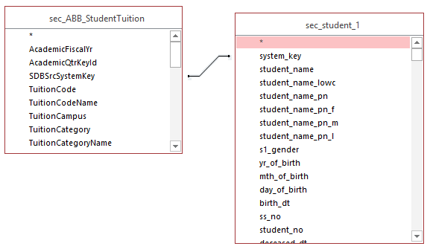
Which students are in a given tuition category?
One record per student per quarter
From UWSDBDataStore in EDW. One record per student. This gives you name and student id.
A

Slide 33
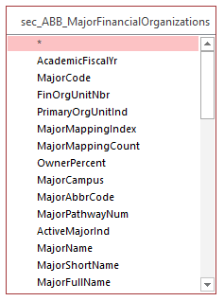
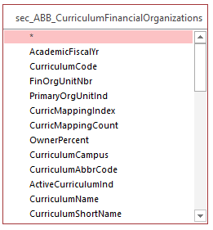
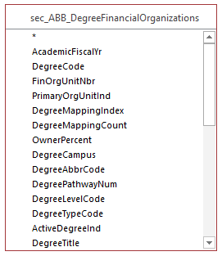
What curricula/majors/degrees are mapped to my unit?
Choose a particular AcademicFiscalYr
Select for the left 3 characters in FinOrgUnitNbr = college code
MajorFullName
CurriculumName
DegreeTitle
B

Slide 34
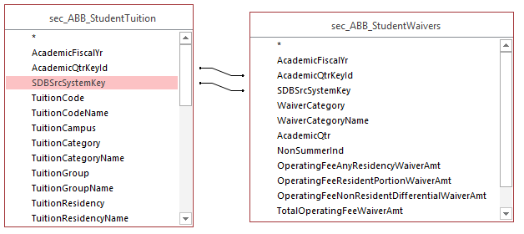
What kinds of waivers do students in a given tuition category receive?
Find student/tuition group in which you are interested
Sum TotalOperatingFee WaiverAmt, group by WaiverCategory
C

Slide 35
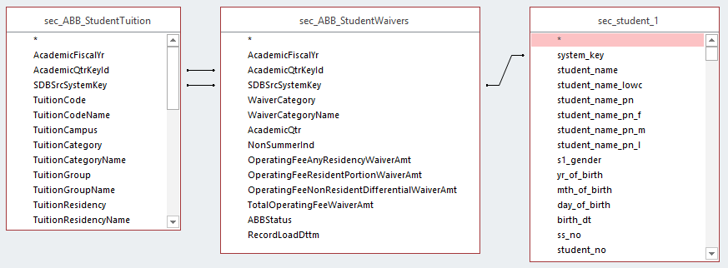
How can I find out what unit has appointed a student receiving a waiver?
Find tuition category or group in which you are interested
Find students with TotalOperatingFee WaiverAmt>0 in WaiverCategory =1 or 2
Get Student Id #
D

Slide 36
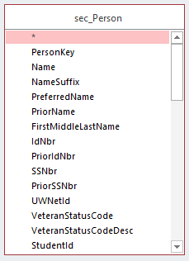
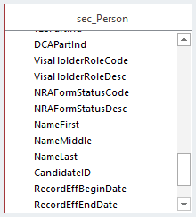
Connect to HR data
(Note that, when you use HumanResources tables, you aren’t dealing with snapshot tables, so you have to pay attention to RecordEffBeginDate and RecordEffEndDate)
Using StudentId, get PersonKey and IDNbr from Person table in Human Resources db in EDW
D

Slide 37
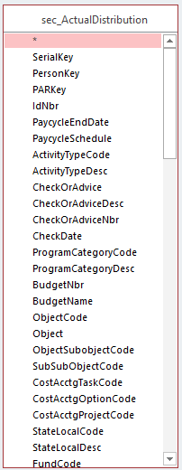
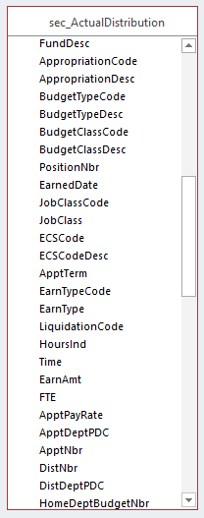
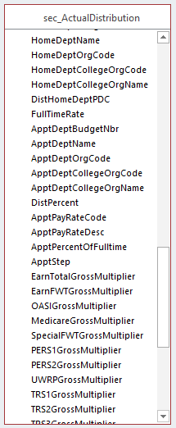
Find appointing department(s)
Possible approach:
Find appointments where:
Where ECSCode=‘G’
EarnTypeCode Like ‘G*’
Get school/college from left three digits of ApptDeptOrgCode
Could determine division between units (if >1 appointing department) on basis of FTE
D

Slide 38
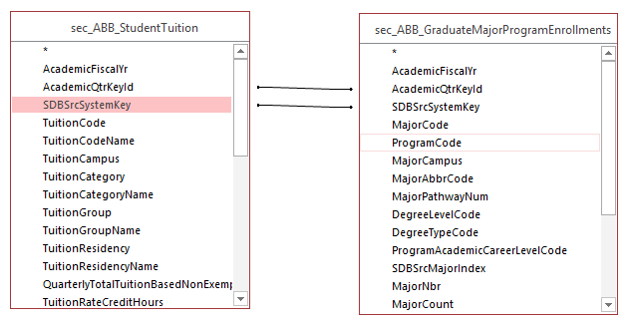
Which students have multiple majors?
Find tuition category or group in which you are interested
Where MajorCount>1, the student has multiple major enrollments in a quarter
E

Slide 39
Which curricula, majors, degrees map to more than one department?
F

Slide 40
What questions do you have?

